Slide 1
WEIGH AND PAY SYSTEM
TEAM GUIDE : ATCHYUTA RAO
TEAM MEMBERS:
M.PRAVEEN (146C1A0544)
B.RAVI KISHORE(146C1A0507)
M.MANIKYAM(146C1A0546)

Slide 2
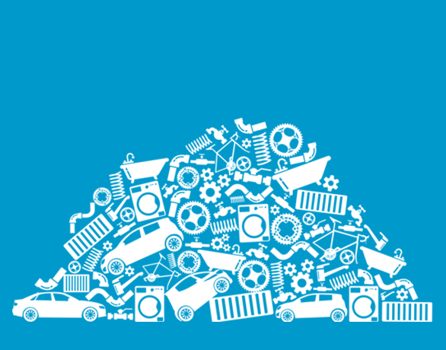
Contents
Abstract
Introduction
Problem definition
Software Requirements Specification
Design
Screenshots
Test Cases
Conclusion
References

Slide 3
ABSTRACT
Every office is now transforming into a paperless system after the advancement of technology. The transactions made in the small scrap industries are entered on papers manually which results in paper wastage and time consuming process. To overcome this problem we introduced an application through which the scrap industries can enter their daily transactions. The transactions are classified as buying,selling and weigh bridge process. The buying and selling transactions are daily process. The weigh bridge process is optional for the scrap industries which include large amount of materials in tons. The profit of coming year is predicted by the application based on the previous year incomes. This helps the organization to make their decisions for the coming years. The transaction history is maintained which is useful for the user to see his past transaction. The predicted values are presented on the graph. The user can also send invoice to the customers through email service provided in the application. The users can also view the tender details through mstc link, this helps the user to buy the materials through tenders.

Slide 4
INTRODUCTION
Paperless System : We are providing a responsive web application using bootstrap and python with firebase as a database.
Machine Learning: We use machine learning for training the datasets i.e, analyzing and predicting the results for the observations.
Arima Model: We use Matplotlib environment for representing the results in graphs. Finally the graphs are produced after analysis of observations using this model.For analysis of the observations required following stages :environment,problem description,validation datasets,persistence,data analysis,arima model.

Slide 5
Problem Definition
The following part explains the existing problems in the reality and what we propose to improve the system drastically such that the outcome is simplified and sustainable.
In the existing system the main problem was data is entered manually on papers which is time taken process. Forecasting of income is difficult in this system.

Slide 6
Proposed System
Providing a paperless transaction system for small scale scrap industry makes easy to enter the transactions without the use of calculator.
By this application they can preview the transaction history and tender details.
We provide the analysis of the business yearly which helps the user to make decision for upcoming year.

Slide 7
SOFTWARE REQUIREMENTS
Languages: HTML,CSS,BOOTSTRAP,JS,Python,ML(Arima Model)
Databases: FIREBASE from GOOGLE
Operating System: MAC,Ubuntu and any windows OS

Slide 8
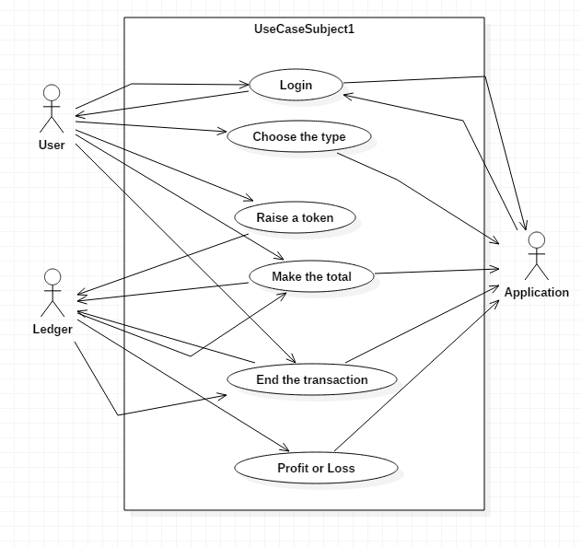
Use-case Diagram

Slide 9
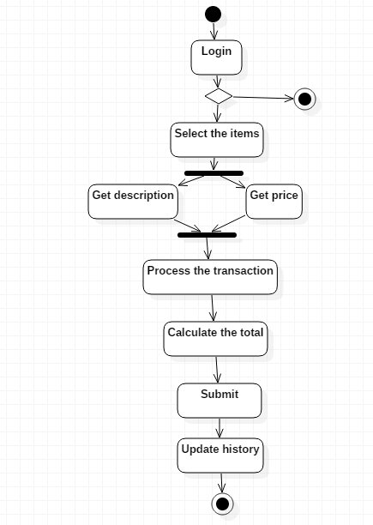
Activity Diagram

Slide 10
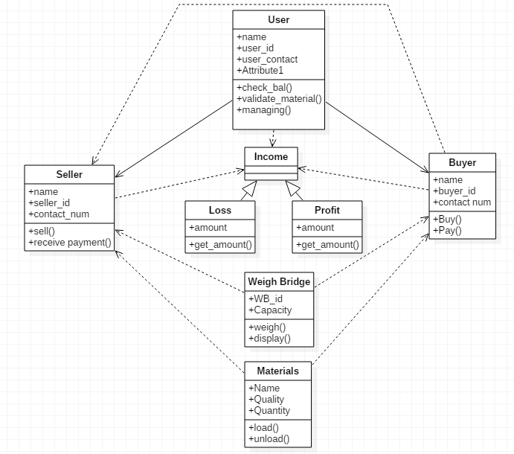
Class Diagram

Slide 11
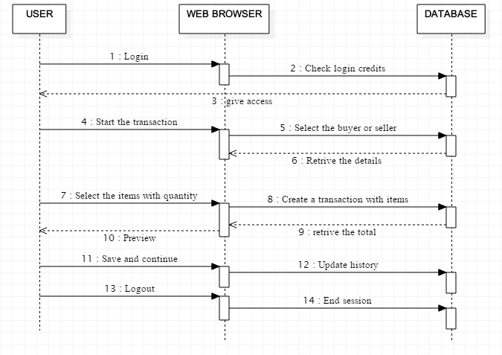
Sequence Diagram

Slide 12
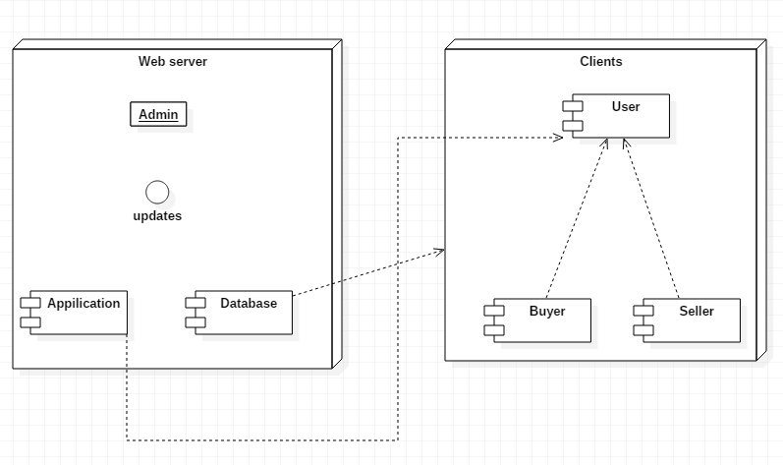
Component and Deployment Diagram

Slide 13
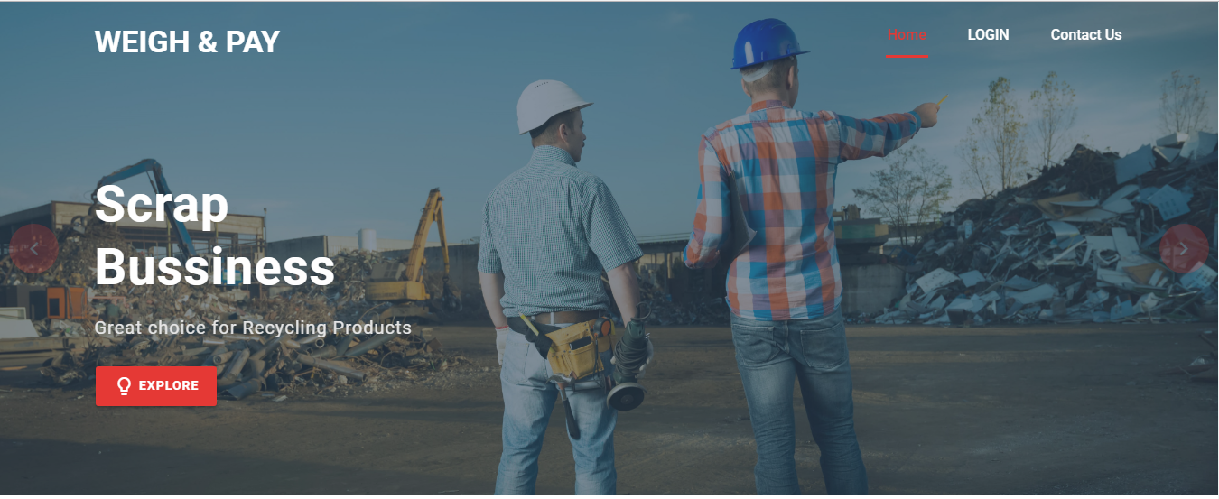
Screenshots

Slide 14
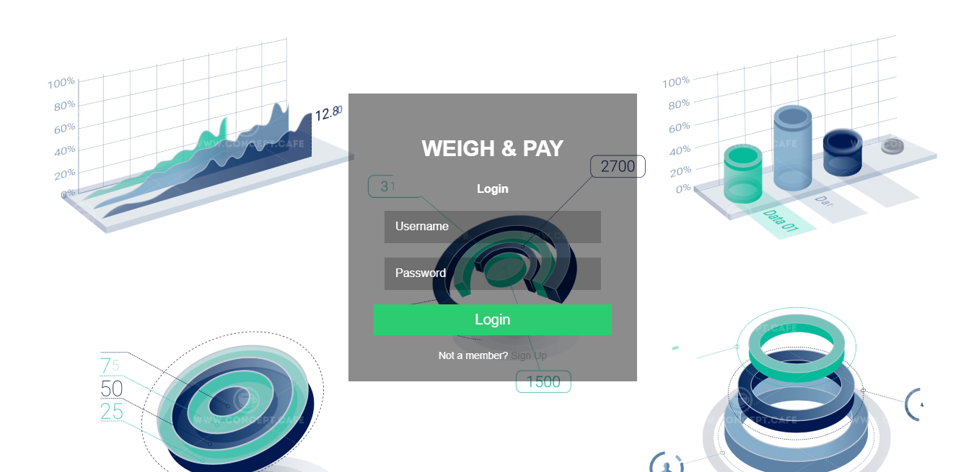
Login Page

Slide 15
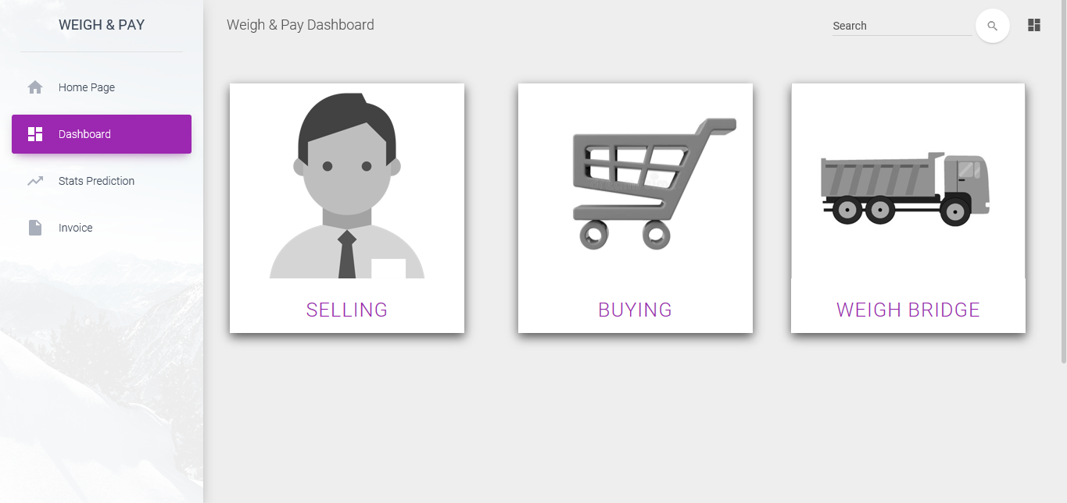
Dashboard

Slide 16
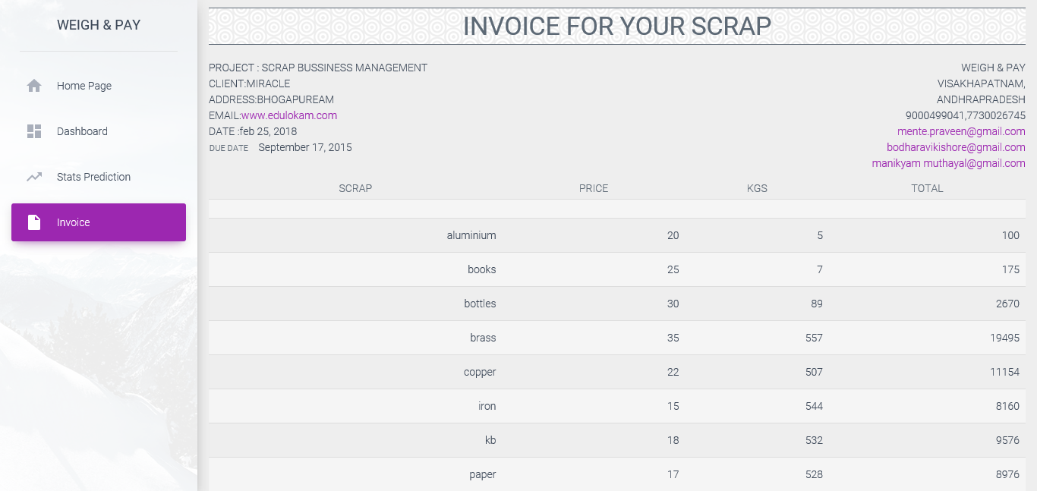
Invoice

Slide 17
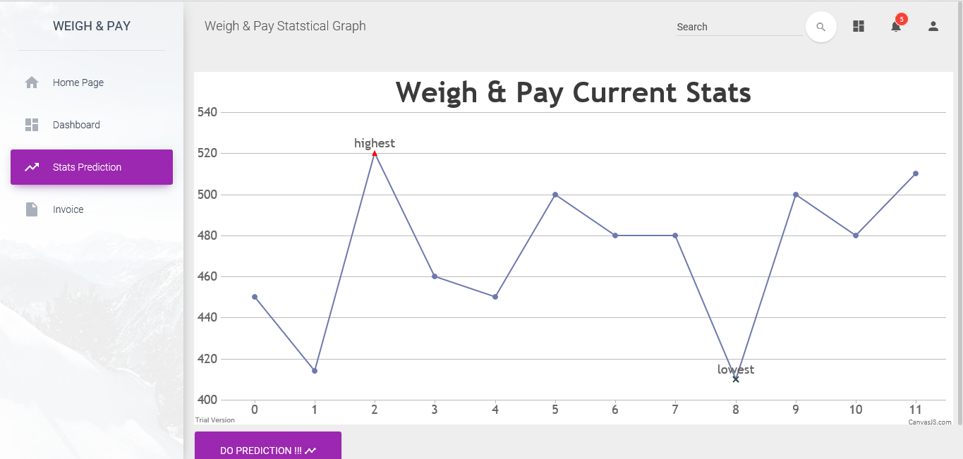
Stats Prediction Page

Slide 18
Test Case - 1
Test Case Id | 1
Method to be tested | Login validation
Test Data | Username and Password are valid
Description | Clicking the login button checks valid user and password
Expected Output | Redirect to specific dashboard page for specific user
Test Status | Pass

Slide 19
Test case - 2
Test Case Id | 2
Method to be tested | Choose the type of transaction
Test Data | Clicking the Buying, Selling and Weigh Bridge buttons
Description | By clicking the specific button should redirect to their respective pages
Expected Output | Redirect to specific type page
Test Status | Pass

Slide 20
Test case - 3
Test Case Id | 3
Method to be tested | Invoice Generation
Test Data | Invoice data from database
Description | Invoice should be generated for the valid user from the database
Expected output | Invoice of particular user transaction will be printed
Test Status | Pass

Slide 21
Test case - 4
Test Case Id | 4
Methods to be tested | Mstc Page link
Test Data | Clicking the button
Description | By clicking the button should redirect to the mstc page link
Expected output | Redirect to the valid page link
Test Status | Pass

Slide 22
Future Scope
The proposed system can be extended by installing a IOT device to weighing machine which scan the type of metal and automatically give the details of the material and its quantity. This avoid the manual entering of transactions. This automation will scans the type, quantity and price of a particular material. It can also extended by maintaining user tender details in the database and can also predict the profit of buying that particular tender. A chat bot can be used to give information and also take feedback from the user which increases the interaction between the user and the application can be updated on the basis of user requirements.

Slide 23
Conclusion
This application “Weigh and Pay ” is developed mainly to overcome the problem faced by the scrap industries while entering their daily transactions manually. The proposed system overcomes all the problems faced by the scrap industries by providing a robust system suitable for market. This application is completed and tested successfully by using the test cases. It provides all the features which are essential for the development of every organization. However, this application also provide forecasting of coming year income in graph which helps the organization to take decisions accordingly. There are no applications till now developed to give support to the scrap industries and features needed for them to develop. This application will provide them a good platform for transaction automation, view the tender details and analysis of income data.

Slide 24
References
www.google.com
http://www.mstcindia.co.in/TenderEntry/tender_auction_Vizag.aspx
www.Stackoverflow.com

Slide 25
Queries

Slide 26
THANK YOU

